Slide 1
Python Problem Solver

Slide 2
Get to know each other
I’m Bryan
Introduce each student:
Age / year
What have learned before?
What do you want to achieve?
What other hobbies do you have?
Write a name plate
Notes:
Introduce myself (5)
Introduce each student: (3 each)
Age / year
What have learned before?
What do you want to achieve?
What other hobbies do you have?
Write a name plate

Slide 3
Course objectives
Using Python to solve real life problems,
Building algorithmic thinking,
Data structures and algorithms,
Set foundation for high school Software Engineering, Enterprise Computing and related subjects,
Prepare for AIO and further competitions
John Von Neumann

Slide 4
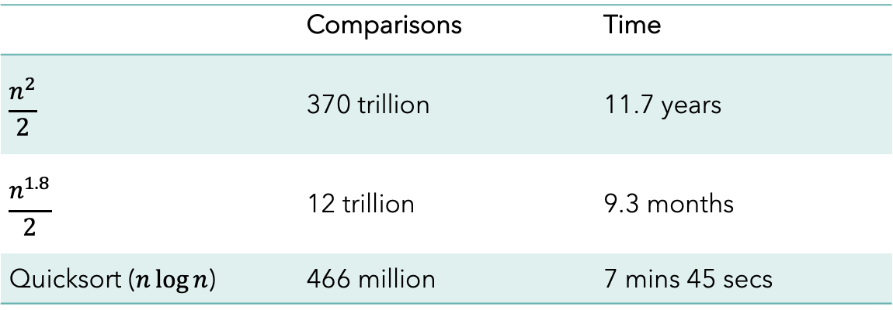
24 bubble sort
Almost all software systems will need to sort data in a particular order.
Problem: Sort 27.2 million data records, how long does it take?
 | Comparisons | Time
$$\frac{n^{2}}{2}$$ | 370 trillion | 11.7 years
$$\frac{n^{1.8}}{2}$$ | 12 trillion | 9.3 months
Quicksort ($n\log{n}$) | 466 million | 7 mins 45 secs

Slide 5
24 bubble sort
There are many different sorting algorithms, each with different space and time complexity, and different use cases.
The simplest is the bubble sort.
https://sortvisualizer.com/bubblesort/
You keep scanning the entire list from left to right, each time swapping a pair of adjacent numbers if they are not in order.
Now you see why it’s called bubble sort?

Slide 6
24 Bubble Sort
Plan (sort in ascending order):
Prepare the input list
Loop i from 1st to last:
Loop j from last to i+1:
if list[j] < list[j-1]:
swap list[j] with list[j-1]
Output list

Slide 7
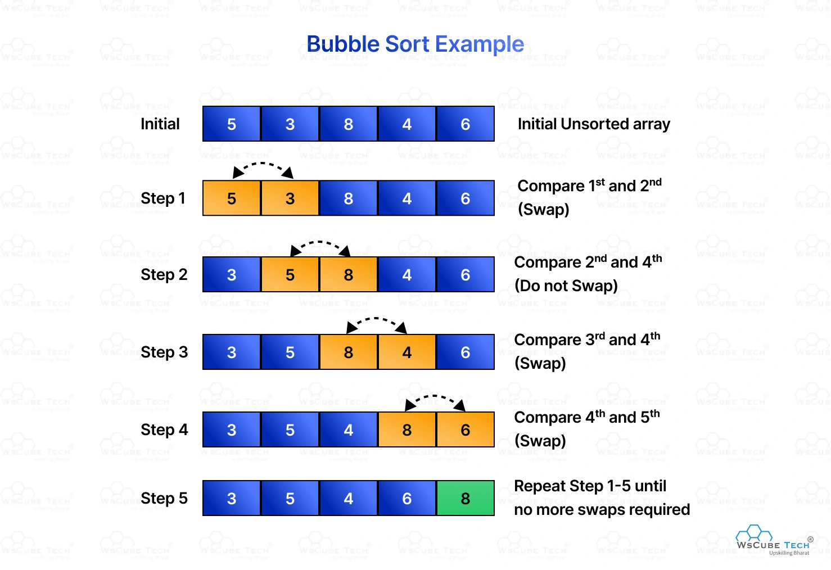
24 bubble sort
Code explained

Slide 8
23 The Vigenère Cipher
There are many different sorting algorithms, each with different space and time complexity, and different use cases.
The simplest is the bubble sort.
https://sortvisualizer.com/bubblesort/
You keep scanning the entire list from left to right, each time swapping a pair of adjacent numbers if they are not in order.
Now you see why it’s called bubble sort?

Slide 9
24 Bubble Sort
Plan (sort in ascending order):
Prepare the input list
Loop i from 1st to last:
Loop j from i+1 to last:
if list[j] < list[j-1]:
swap list[j] with list[j-1]
Output list

Slide 10
25 conway’s game of life
https://en.wikipedia.org/wiki/Conway%27s_Game_of_Life
It’s a zero-player game, meaning that its evolution is determined by its initial state, requiring no further input. You create an initial configuration and observe how it evolves.
The universe of the Game of Life is an infinite two-dimensional orthogonal grid of square cells, each of which is in one of two possible states, alive or dead, or “populated” or “unpopulated”. Every cell interacts with its eight neighbours.
At each step in time, the following transitions occur:
Any live cell with fewer than two live neighbours dies.
Any live cell with two or three live neighbours lives on to the next generation.
Any live cell with more than three live neighbours dies.
Any dead cell with exactly three live neighbours becomes a live cell.

Slide 11
25 conway’s game of life
The initial pattern constitutes the seed of the system. The first generation is created by applying the above rules simultaneously to every cell in the seed — births and deaths occur simultaneously.
The rules continue to be applied repeatedly to create further generations.
There are different seeds we can try. Or just random 15x15.
The Glider
The Toad
The Beacon
The Pulsar

Slide 12
25 conway’s game of life
Plan
Prepare the data structure for grid

Slide 13
Exercises

Slide 14
Thank you

